Slide 1
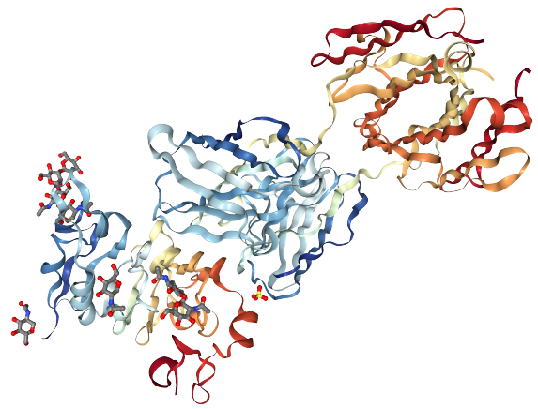
Lung Cancer Drug Discovery
By: Atharva pandit, Shubham patil, Rahul ubale, and Rahul g.s.

Slide 2
Aim
To predict the effectivity of a drug, against Lung cancer cell.

Slide 3
Motivation
EGFR (Epidermal Growth Factor Receptor)-positive lung cancer represents about 10-15% of lung cancer in the United States and results in one of the most aggressive tumors.
Initially, there was a lack of sufficient data to perform a prediction. However, with the efforts of scientists, we now have enough data to perform such a prediction.
Hence, whenever we want to test the efficacy of a compound in lung cancer treatment, we can predict it using our methods.

Slide 4
Methodology
We have divided the project into 4 parts:
Data collection
Exploratory data analysis
Descriptor calculation
Feature ENGINEERING AND Model building

Slide 5
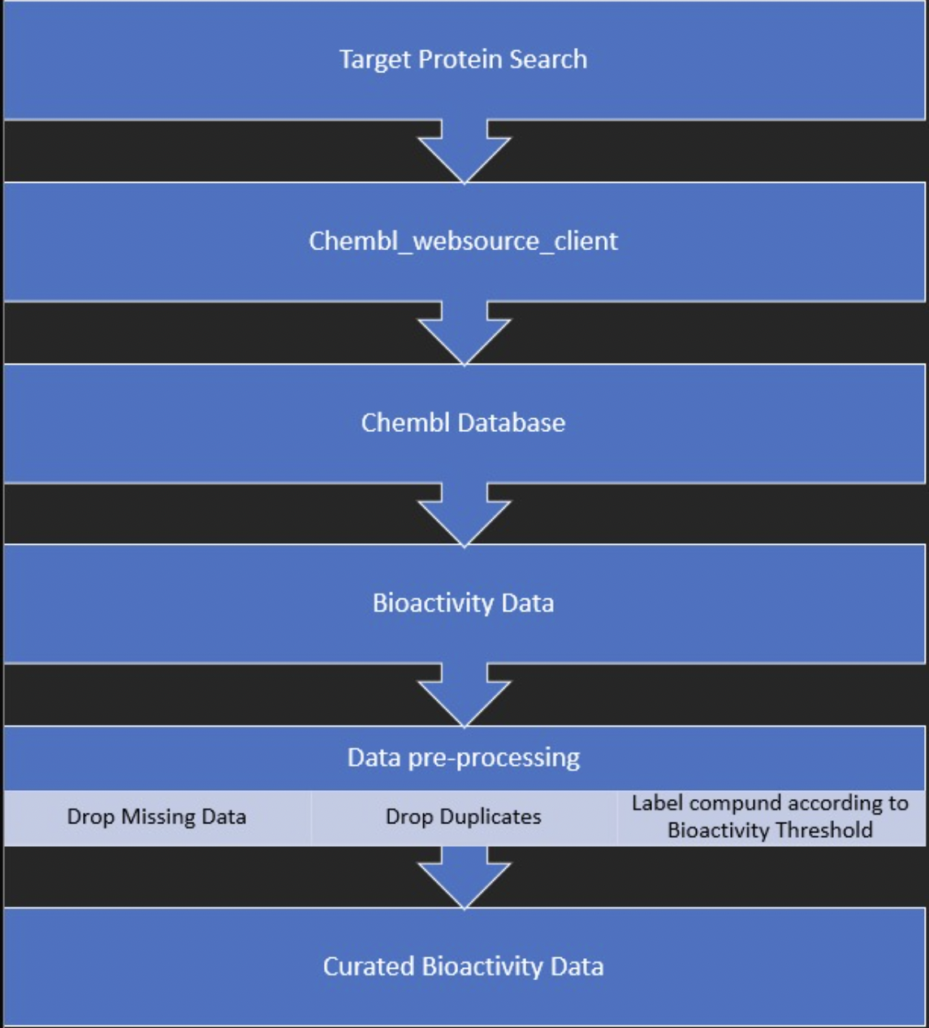
1. Data Collection:
Selecting the target protein search.
Collecting data from ‘chembl’ database.
Data cleaning
Curating Bio activity data

Slide 6
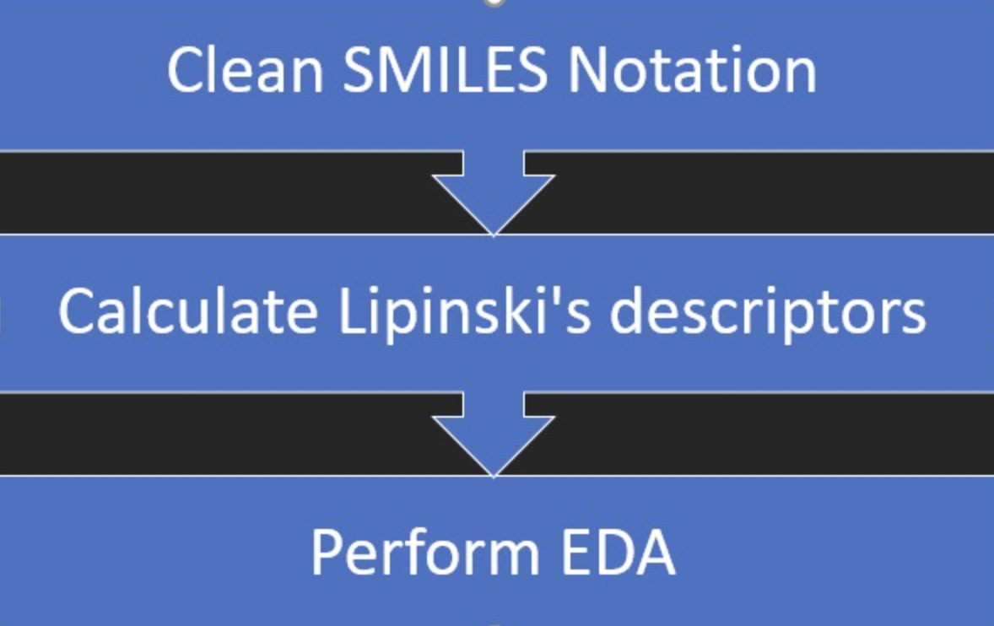
2. Exploratory data analysis
Clean SMILES Notation
Remove small organic compounds
Remove salt
Calculate Lipinski’s descriptors
Log P
No. H-bond donor
No. H-bond acceptor
Perform EDA

Slide 7
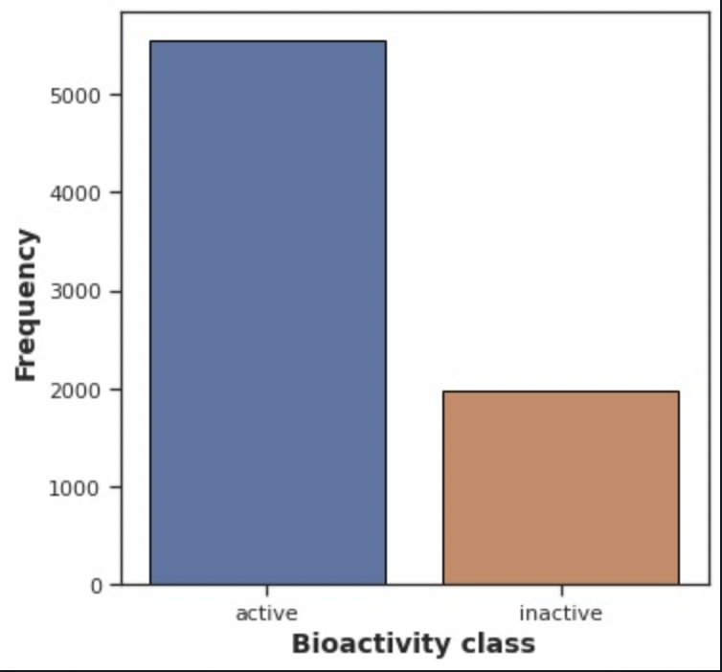
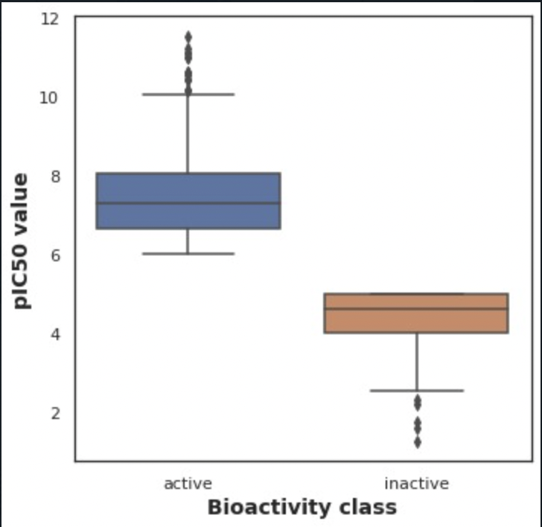
Exploratory Data Analysis - 1

Slide 8
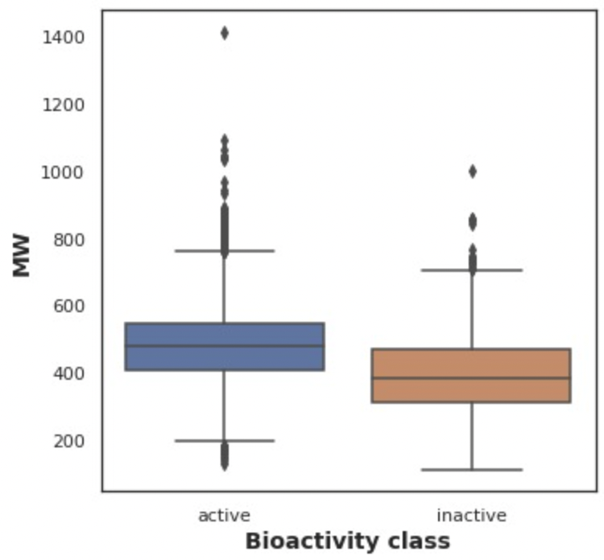
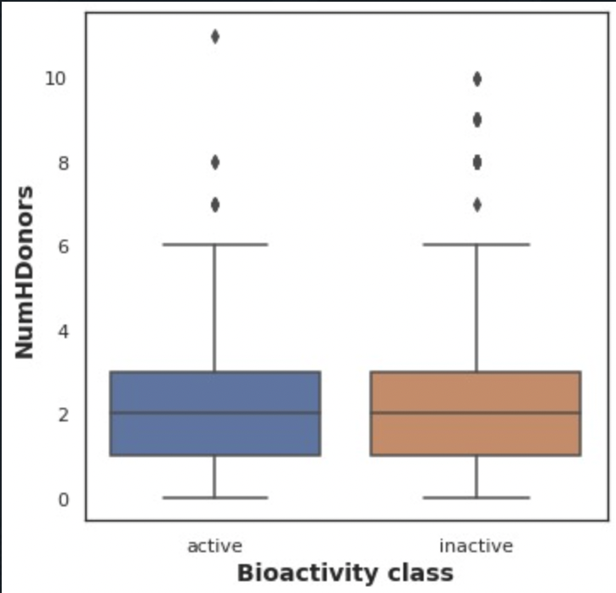
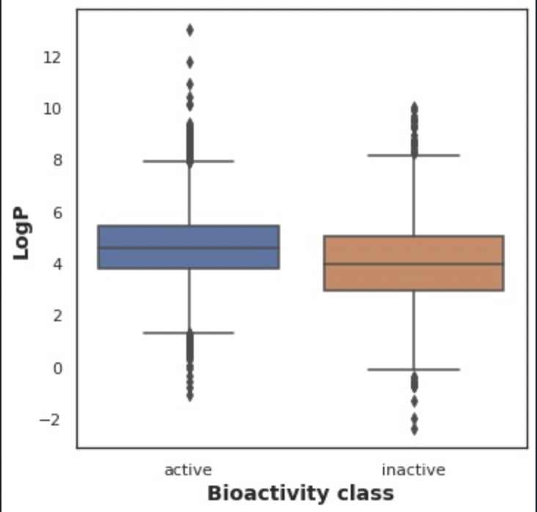
Exploratory Data Analysis - 2

Slide 9
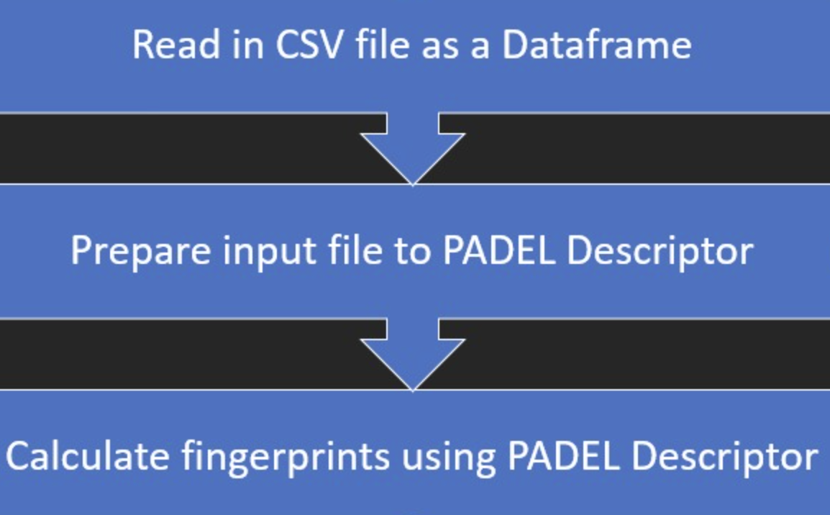
3. Descriptor calculation
Read CSV file as a Dataframe
Prepare input file to PADEL Descriptor
Calculate fingerprints using PADEL Descriptor

Slide 10
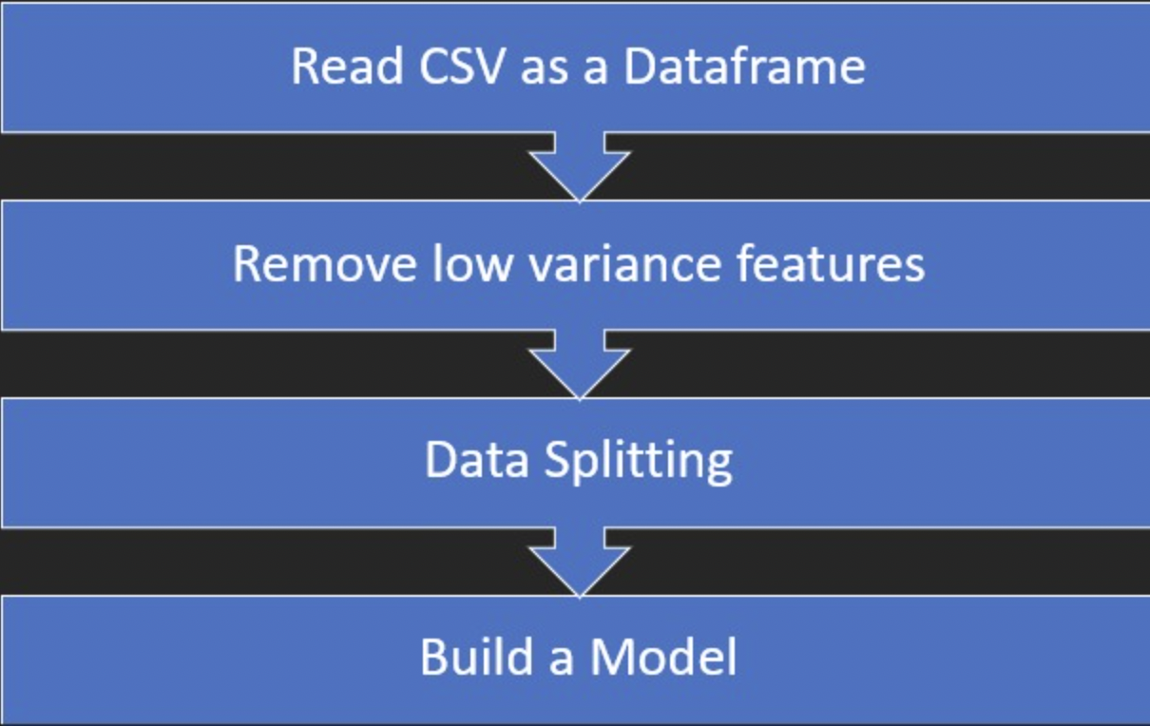
4. Feature Engineering and Model building
Read the new CSV as a Dataframe
Remove low variance features
Data Splitting
Build a Model

Slide 11
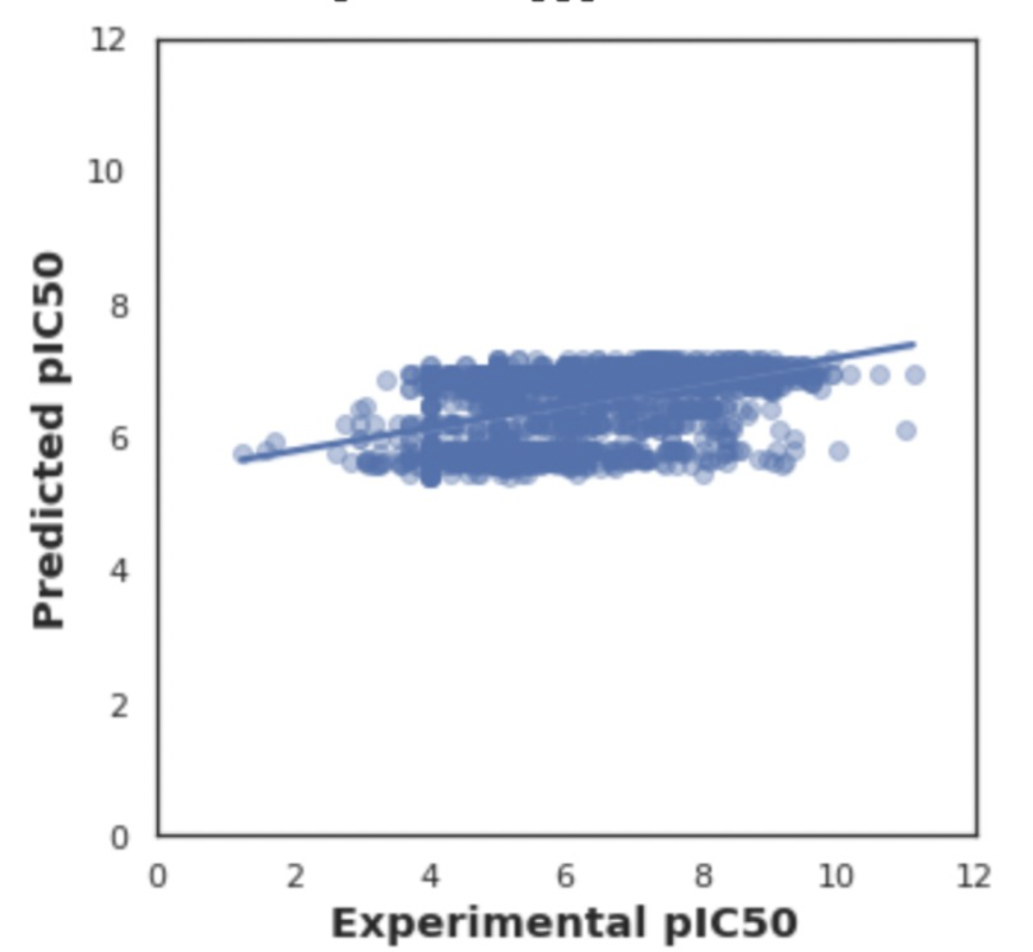
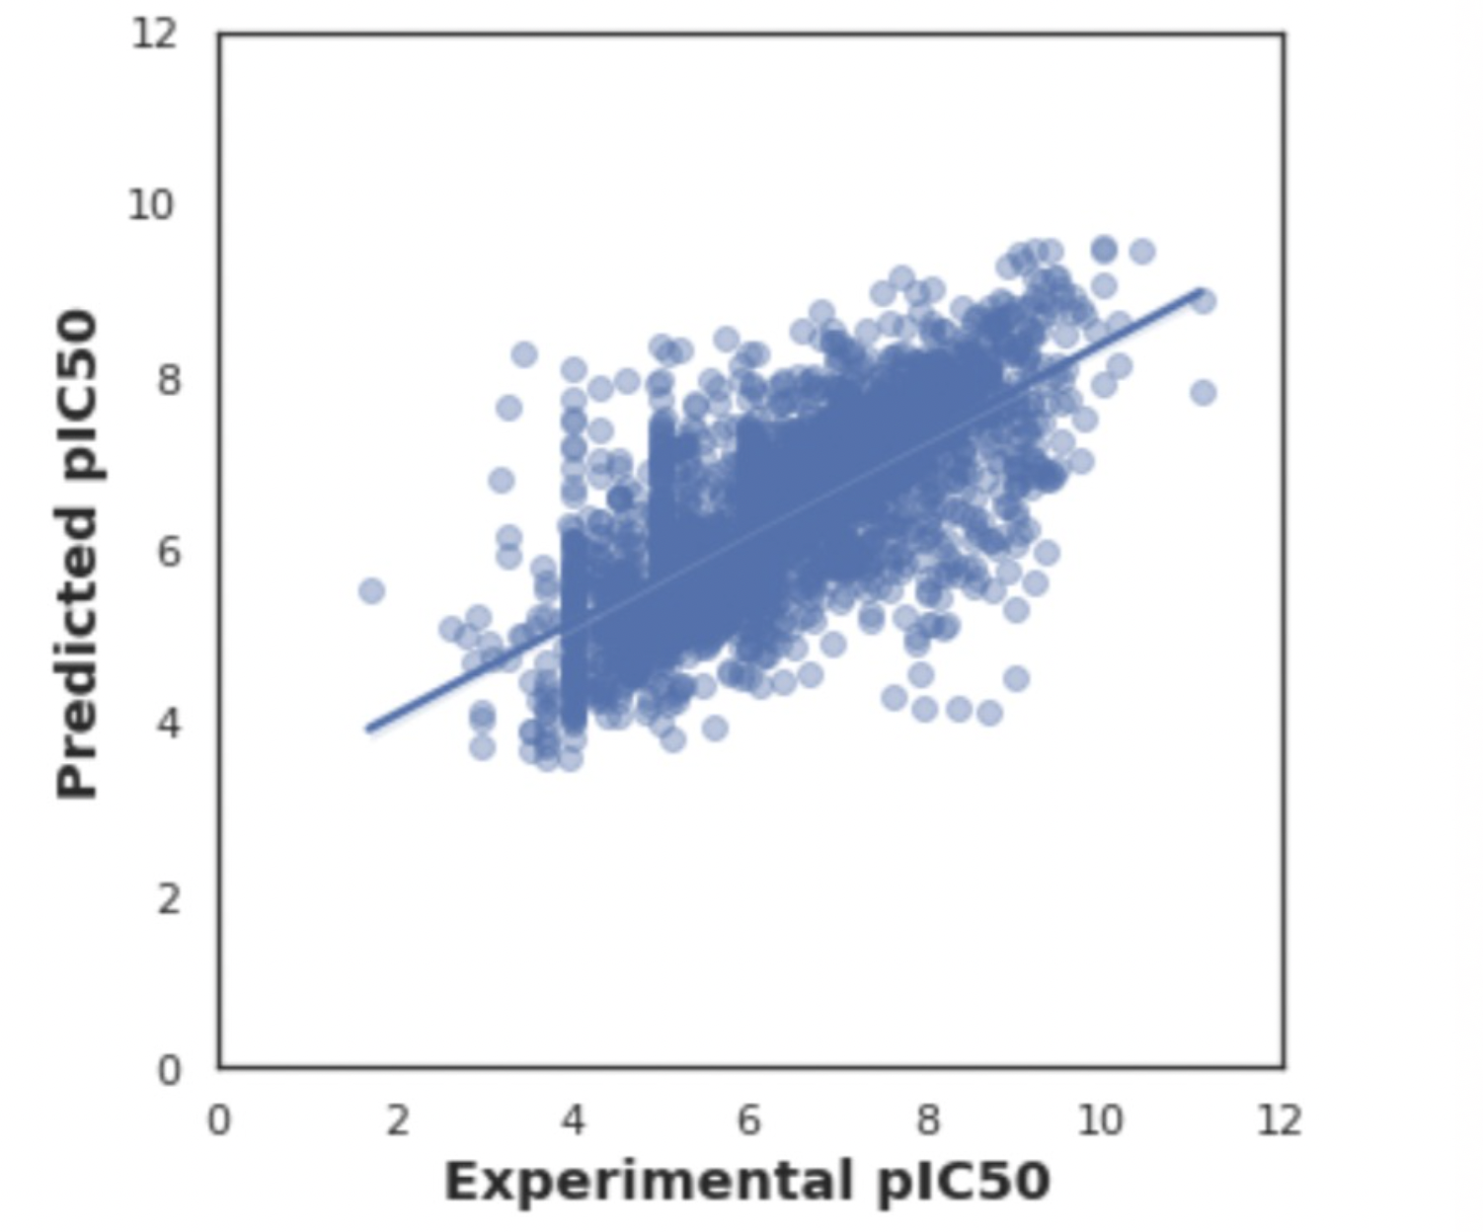
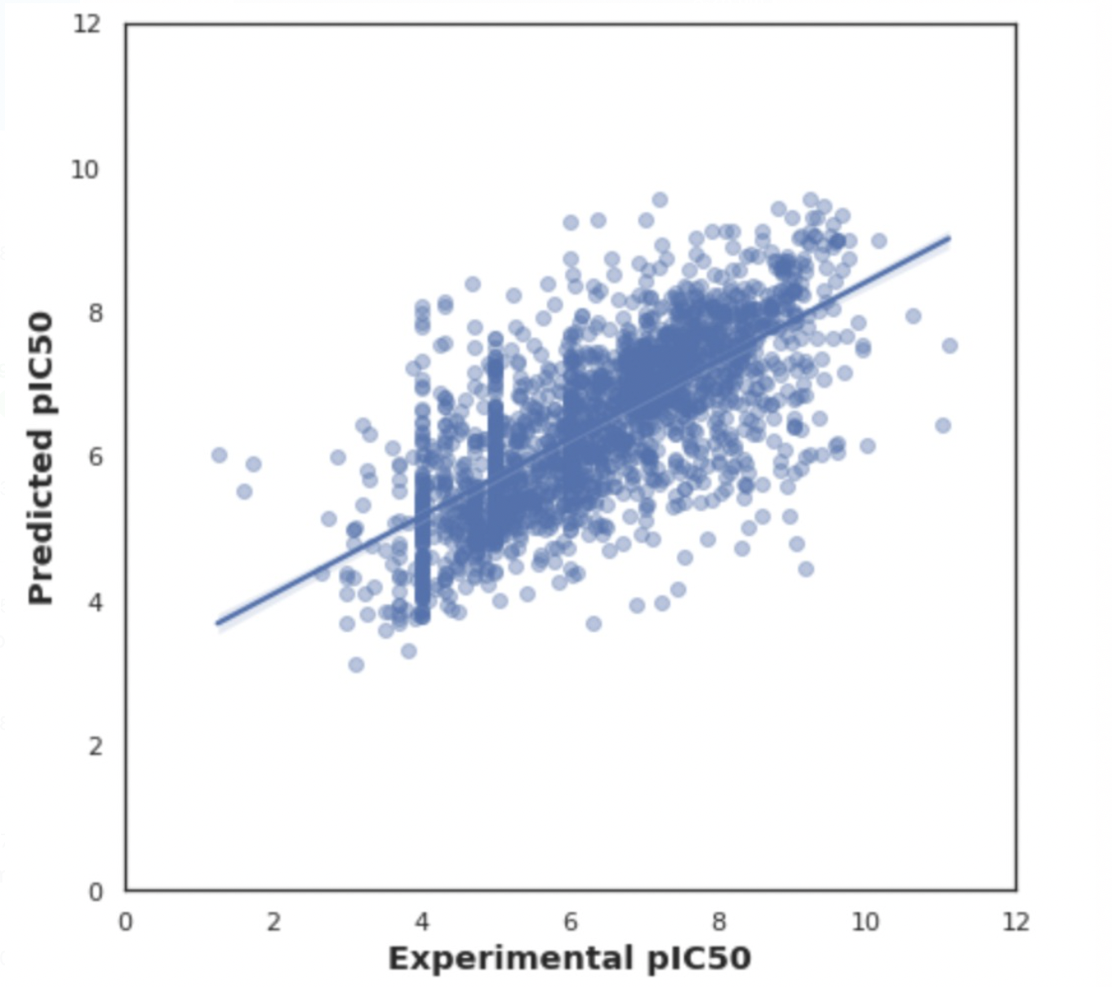
Intermediate Results
AdaBoost Regressor
Random Forest Regressor
Bagging Regressor

Slide 12
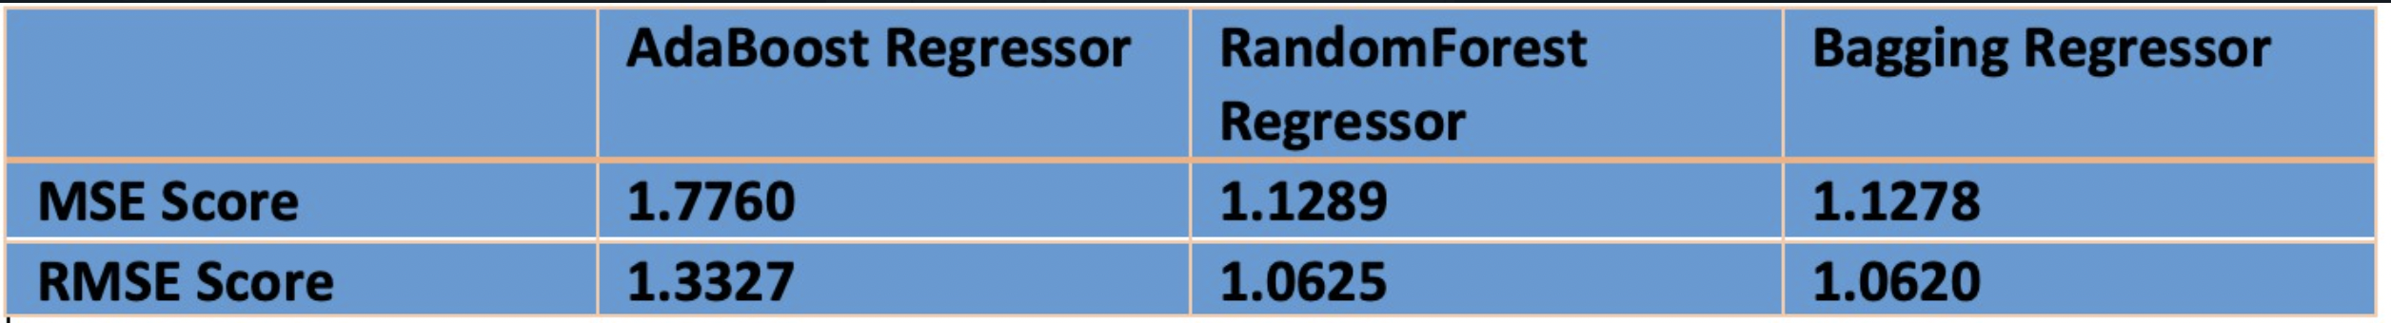
Mean Squared Error and Root Mean Square Error of the Models

Slide 13
Thank You

